Slide 1
Design and Implementation

Slide 2
Software Design and Implementation
The process of converting the system specification into an executable system.
Software Design: Design a software structure that realises the specification.
Implementation: Translate this structure (Design) into an executable program.
The activities of design and implementation are closely related and may be inter-leaved.

Slide 3
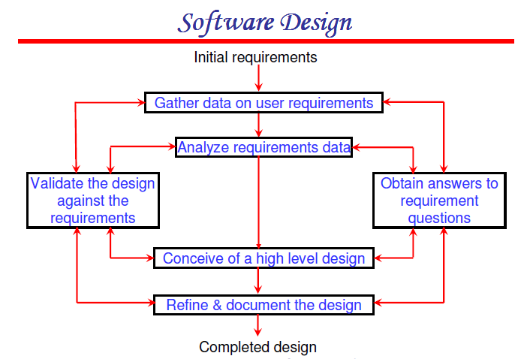

Slide 4
The Design Phase
High-level (Architectural) Design: Consists of developing an architectural structure for software programs, databases, the user interface, and the operating environment.
Low-level (detailed) Design: Entails developing the detailed algorithms and data structures that are required for program development.

Slide 5
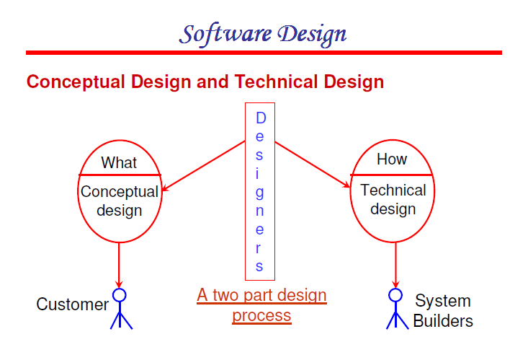

Slide 6
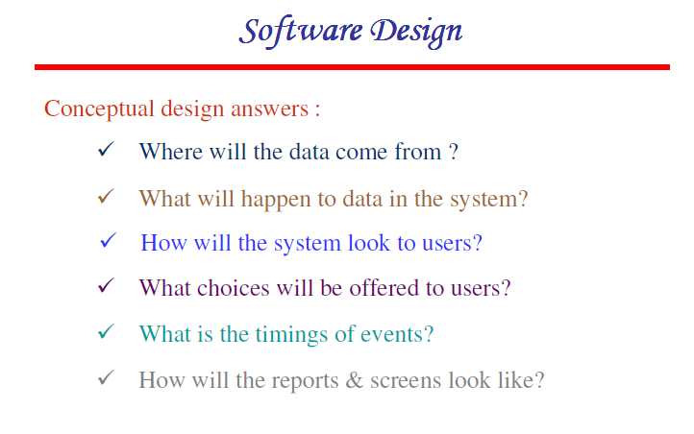

Slide 7
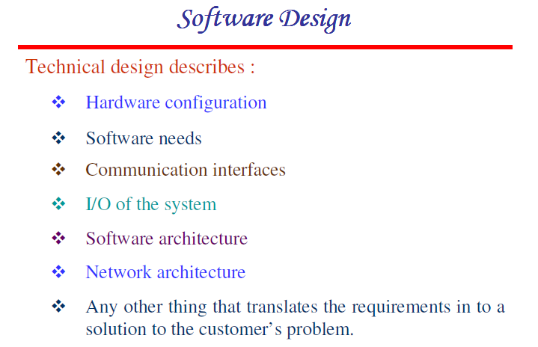

Slide 8
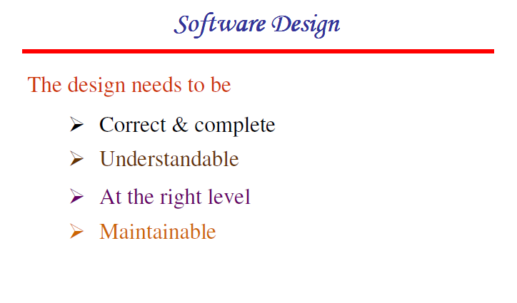

Slide 9
The Implementation Phase
Primary objectives are to ensure that System is built, tested and installed (actual programming of the system).
The implementation phase includes six activities:
Construct software components.
Verify and test.
Develop prototypes for tuning.
Train and document
Install the system.
.

Slide 10
Design
Designer plans to produce a s/w system which is
Functional
Reliable
Easy to understand, modify, & maintain
SRS manifested with functional, information, and behavioral models feed the design process
Design produces
Data Design
Architecture Design
Procedural Design
Interface Design

Slide 11
Design Process Activities
Architectural Design.
Abstract Specification.
Interface Design.
Component Design.
Data Structure Design.
Algorithm Design.

Slide 12
The Software Design Process

Slide 13
Design Models ?
Data Design
Created by transforming the data dictionary and ERD into implementation data structures
Requires as much attention as algorithm design
Architectural Design
Defines relationship b/w structural elements of the software.
Derived from the analysis model and the subsystem interactions defined in the DFD
Interface Design
Derived from DFD and CFD and describes software elements communication with other software elements, other systems, human users
Procedural Design
Transforms structural elements into procedural description

Slide 14
Architectural Design
Layered Architecture: Consists of multiple layers like
Core Layer.
Utility Layer.
Application Layer.
User Interface Layer.
Data Centered Architecture: Central database is processed through other components which add, delete, and update the data.
Data Flow Architecture: Applied when input data is to be transformed into output data through a series of components. Generally uses concepts of pipes and filters.
Object Oriented Architecture: Data and operations encapsulated together and communication among objects is through message passing.

Slide 15
Importance of Design
Design is a phase where quality is fostered.
Without proper design we risk building an unstable software.
Design acts as a foundation for all subsequent phases.

Slide 16

Importance of Design

Slide 17
What Is a Module?
A lexically contiguous sequence of program statements, bounded by boundary elements, with an aggregate identifier
“Lexically contiguous”
Adjoining in the code
“Boundary elements”
{ ... }
begin ... end
“Aggregate identifier”
A name for the entire module

Slide 18
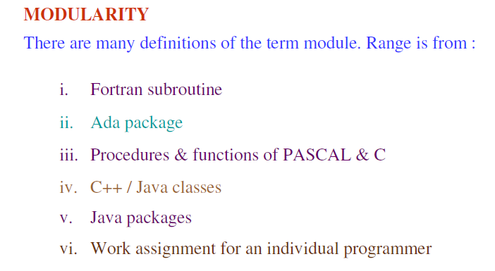

Slide 19
Modularity
Attribute of the s/w that allows it to be managed intellectually.
A monolithic s/w can’t be easily grasped by a reader.
Overall efforts
Cost to Interface
Cost of Efforts
Cost to module
Degree of Modularity

Slide 20
Modularity
Attribute of the software that allows a s/w to be managed intellectually.
A monolithic s/w can not be grasped by a reader.
C(x): perceived complexity of the problem
E(x): Effort required to solve the problem
For two problems P1 and P2
IF C(P1) > C(P2) THEN E(P1) > E(P2)
Also it has been observed that
C(P1+P2) > C(P1)+C(P2)
It therefore, follows that E(P1)+E(P2) < E(P1+P2)
Thus it is easier to solve a complex problem if it is divided into manageable pieces (modules).

Slide 21
Control Hierarchy
Organization of program components is depicted through
Depth and width of the structure (graph) representing number of levels of control, and overall span of control.
Concept of FAN-IN and FAN-OUT.
Concept of Super ordinate and subordinate modules.
Concept of Visibility and Connectivity.

Slide 22
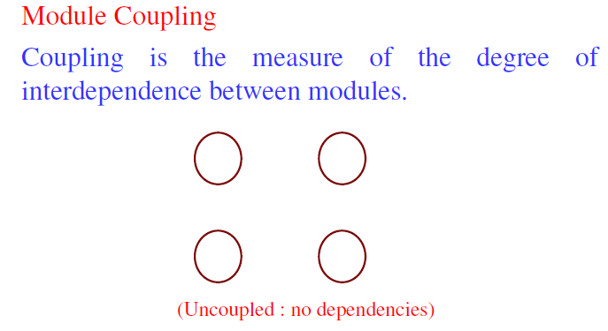

Slide 23
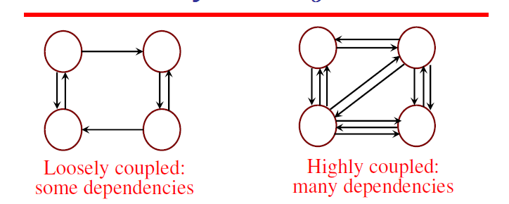

Slide 24
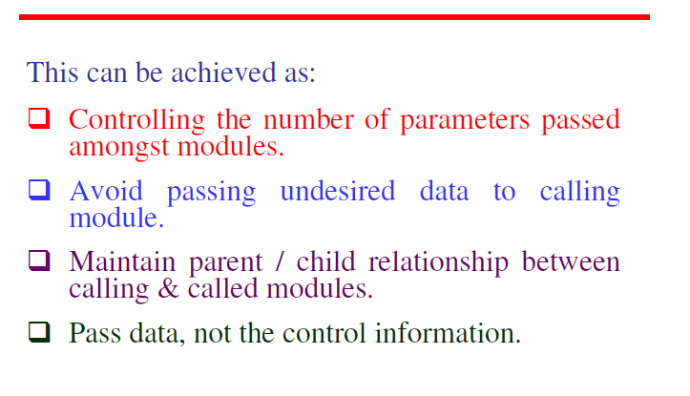

Slide 25
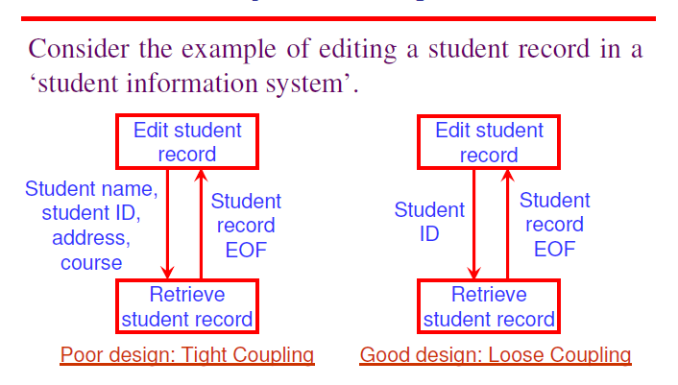

Slide 26
Coupling
A measure of the degree of interaction between two modules. There are seven categories or levels of coupling.
No direct coupling (Good)
Data coupling
Stamp coupling
Control coupling
External Coupling
Common coupling
Content coupling (Bad)

Slide 27
Content Coupling
Two modules are content coupled if one directly references contents of the other.
Example 1:
Module p modifies a statement of module q.
Example 2:
Module p refers to local data of module q in terms of some numerical displacement within q.
Example 3:
Module p branches into a local label of module q.
Why is Content Coupling So Bad?
Almost any change to module q, even recompiling q with a new compiler or assembler, requires a change to module p.

Slide 28
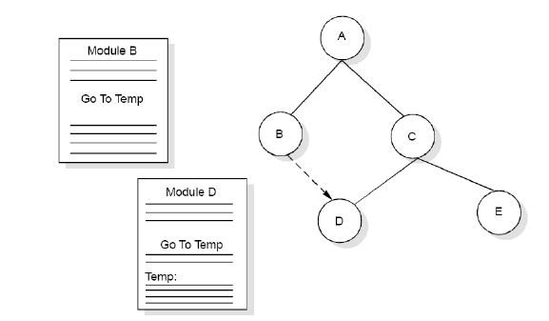
Example

Slide 29
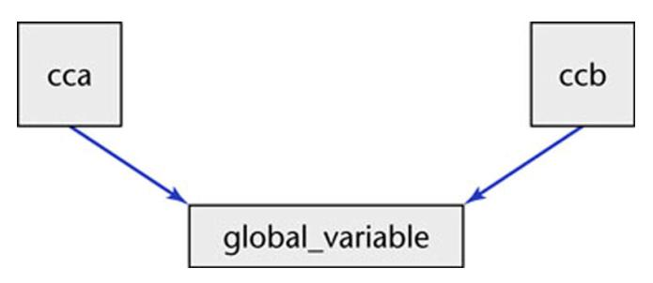
Common Coupling
Two modules are common coupled if they have write access to global data.
Example 1
Modules cca and ccb can access and change the value of global_variable.

Slide 30
Common Coupling (contd)
Example 2:
Modules cca and ccb both have access to the same database, and can both read and write the same record.
Example 3:
FORTRAN common
COBOL common (nonstandard)
COBOL-80 global
C extern

Slide 31
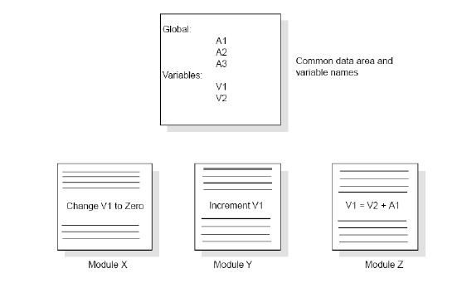
Example

Slide 32
External Coupling
Two modules are externally related by a common data structure or device format etc.
A form of coupling in which a module has a dependency to other module, external to the software being developed or to a particular type of hardware.
This is basically related to the communication to external tools and devices.

Slide 33
Control Coupling
Two modules are control coupled if one passes an element of control to the other.
Example:
A control switch passed as an argument.

Slide 34
Stamp Coupling
Some languages allow only simple variables part_number, degree_of_multiprogramming, satellite_altitude.
Many languages also support the passing of data structures
part_record
satellite_coordinates
segment_table
Two modules are stamp coupled if a data structure is passed as a parameter, but the called module operates on some but not all of the individual components of the data structure.

Slide 35
Data Coupling
Two modules are data coupled if all parameters are homogeneous data items (simple parameters, or data structures and all of whose elements are used by the called module)
Examples:
display_time_of_arrival (flight_number);
compute_product (first_num, second_num);
get_job_with_highest_priority (job_queue);

Slide 36
Coupling Values
Sr. No. | Type of Coupling | Value
1. | Content Coupling | 0.95
2. | Common Coupling | 0.70
3. | External Coupling | 0.60
4. | Control Coupling | 0.50
5. | Stamp Coupling | 0.35
6. | Data Coupling | 0.20
7. | No Direct Coupling | 0.00

Slide 37
Cohesion
The degree of interaction within a module. A measure of the degree to which the elements of a module are functionally related.
Seven categories or levels of cohesion
Functional cohesion (good)
Sequential Cohesion
Communicational cohesion
Procedural cohesion
Temporal cohesion
Logical cohesion
Coincidental cohesion (bad)

Slide 38
Coincidental Cohesion
Coincidental cohesion exists in modules that contain instructions that have little or no relationship to one another.
A module has coincidental cohesion if it performs multiple, completely unrelated actions. For example
print_next_line, reverse_string_of_characters_comprising_second_ parameter, add_7_to_fifth_parameter, convert_fourth_parameter_to_ floating_point.
It’s BAD because:
It degrades maintainability.
A module with coincidental cohesion is not reusable.
The problem is easy to fix by break such module into separate modules, each performing one task.

Slide 39
Logical Cohesion
A module has logical cohesion when it performs a series of logically related actions, one of which is selected by the calling module.
Example 1:
An object performing all input and output.
Example 2:
There are more than one data items of type date in an input transaction. Separate code would be written to check that each date is a valid date. A better way is to construct a DATECHECK module and call it wherever necessary.

Slide 40
Temporal Cohesion
A module has temporal cohesion when it performs a series of actions related in time. May be performed in the same time span. For example
open_old_master_file, new_master_file, transaction_file, and print_file; initialize_sales_district_table, read_first_transaction_record, read_first_old_master_record (a.k.a. perform_initialization)
The set of functions responsible for initialization, setting start up values such as setting program counters or control flags exhibit temporal cohesion. They should not be put in the same function.

Slide 41
Procedural Cohesion
A module has procedural cohesion if it performs a series of actions related by the procedure to be followed by the product. The two components X and Y are structured the same way.
Example:
Calculate student GPA, print student record, calculate cumulative GPA, Print cumulative GPA
read_part_number_and_update_repair_record_on_master_file

Slide 42
Communicational Cohesion
A module has communicational cohesion if it performs a series of actions related by the procedure to be followed by the product, but in addition all the actions operate on the same data.
Two components operate on the same input data or contribute to the same output data.
Example 1:
update_record_in_database_and_write_it_to_audit_trail
Example 2:
calculate_new_coordinates_and_send_them_to_terminal

Slide 43
Functional Cohesion
A module with functional cohesion performs exactly one action.
Example 1:
get_temperature_of_furnace
Example 2:
compute_orbital_of_electron
Example 3:
write_to_floppy_disk
Example 4:
calculate_sales_commission

Slide 44
Sequential Cohesion
More than one functions performed by the module occur in an order prescribed by the specifications.
X outputs some data which forms the input to Y.

Slide 45
Cohesion Values
Sr. NO. | Type of Cohesion | Value
1. | Coincidental | 0.20
2. | Logical | 0.23
3. | Temporal | 0.25
4. | Procedural | 0.40
5. | Communicational | 0.60
6. | Sequential | 0.70
7. | Functional | 0.95

Slide 46
Design Strength
Dependence Matrix
Depicts quantitative measure of dependence of modules.
Used to find strength of design.
Primarily affected by the coupling and cohesion.
Gives the probability of having to change module i given that module j is changed.
First order dependence and complete dependence matrix are found.

Slide 47
First order dependence matrix
Determine coupling among various modules. Generally represented by a coupling matrix C. It is a symmetric matrix i.e. Ci,j = Cj,i
Diagonal elements will be 1 i.e. Ci,i = 1
Strength of various modules is represented by the strength vector S.
FODM is constructed by the following formula
Di,j = 0.15*(Si+Sj)+0.7*Ci,j
= 0 where Ci,j = 0
= 1 where Ci,j = 1
FODM can be represented by a undirected graph with links labeled with the dependence values.
Initial connectivity status of modules can also be depicted by a undirected graph with links assigned the coupling value and nodes the strength value.
FODM does not give a clear picture of dependence because it is not able to incorporate indirect connectivity.

Slide 48
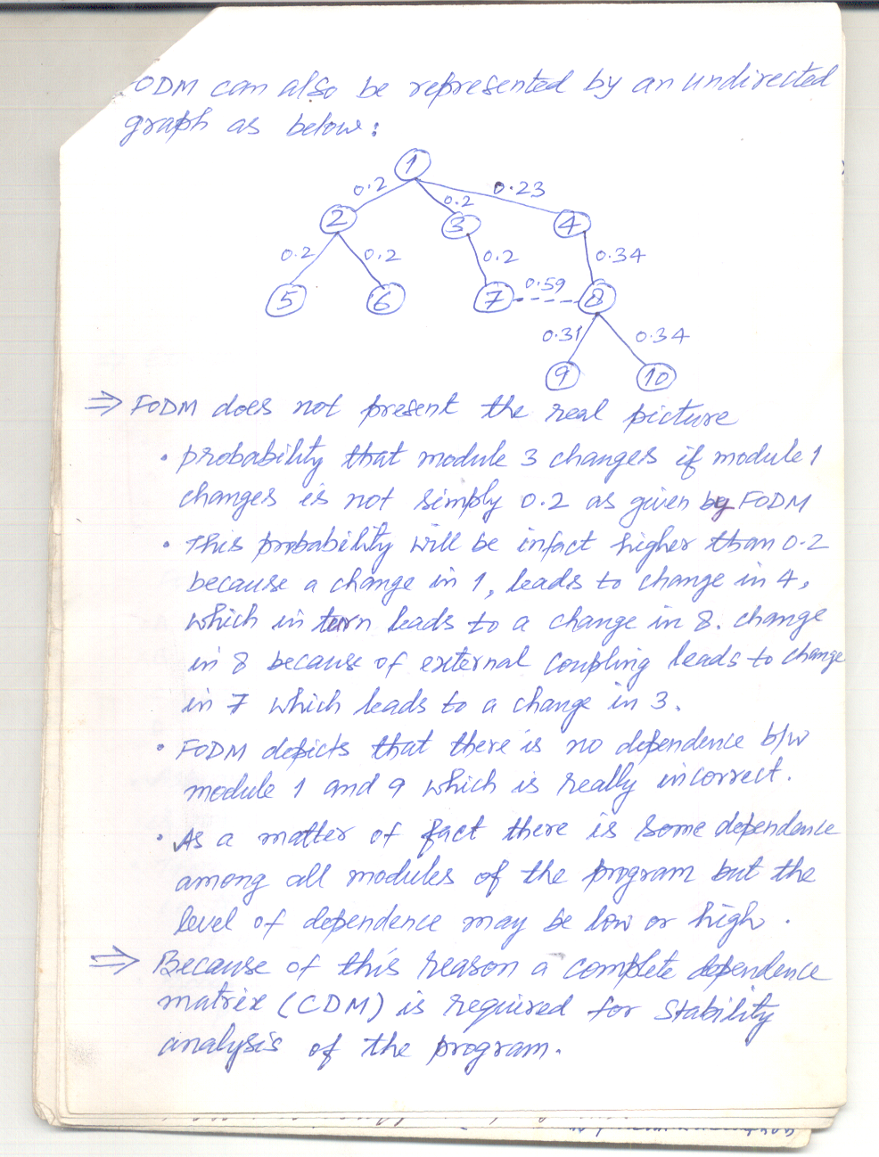

Slide 49
Complete Dependence Matrix
CDM is obtained by finding out all unique paths from one module to all other modules.
Because these paths may not be mutually exclusive to each other, hence addition law of probability is not directly applicable.
IF there are three unique paths to B from A labeled as x, y, and z respectively with probabilities as P(x), P(y), and P(z) THEN
P(B changing) = P(x) + P(y) + P(z) - P(x)*P(y)
- P(y)*P(z) - P(x)*P(z) + P(x)*P(y)*P(z)

Slide 50
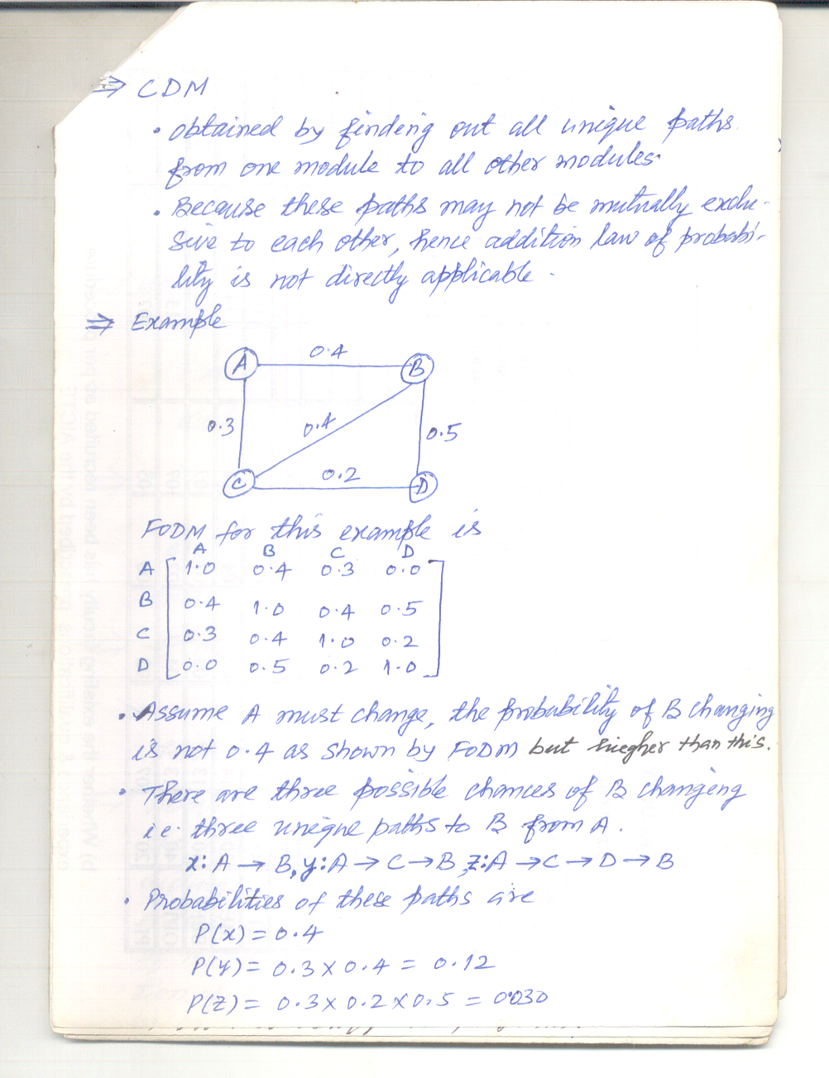

Slide 51
Strength Measures
CDM can be used to find the following measure
Expected Change Measure (ECM) which gives a probability of changing the number of modules if a particular module changes.
ECMi = ΣDi,j where i and j are not equal.
Overall Design Measure (ODM) which gives the expected number of modules to be changed given a module changes.
ODM = Σ Σ Di,j /m for i,j = 1 to m

Slide 52
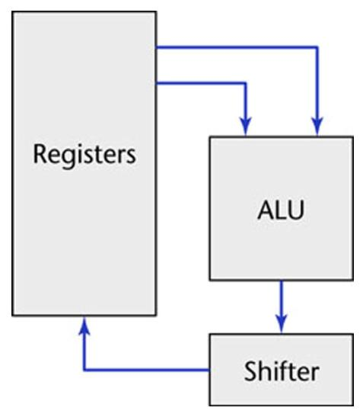
Design of Computer
A highly incompetent computer architect decides to build an ALU, shifter, and 16 registers with AND, OR, and NOT gates, rather than NAND or NOR gates.
Figure 7.1

Slide 53
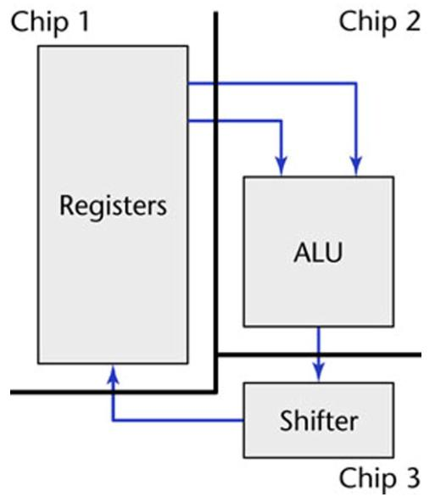
Design of Computer (contd)
The architect designs 3 silicon chips
Figure 7.2

Slide 54
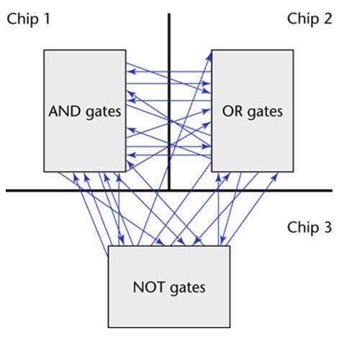
Design of Computer (contd)
Redesign with one gate type per chip
Resulting “masterpiece”
Figure 7.3

Slide 55
Computer Design (contd)
The two designs are functionally equivalent
The second design is
Hard to understand
Hard to locate faults
Difficult to extend or enhance
Cannot be reused in another product
Modules must be like the first design
Maximal relationships within modules, and
Minimal relationships between modules

Slide 56
Composite/Structured Design
A method for breaking up a product into modules to achieve
Maximal interaction within a module, and
Minimal interaction between modules
Module cohesion
Degree of interaction within a module
Module coupling
Degree of interaction between modules

Slide 57
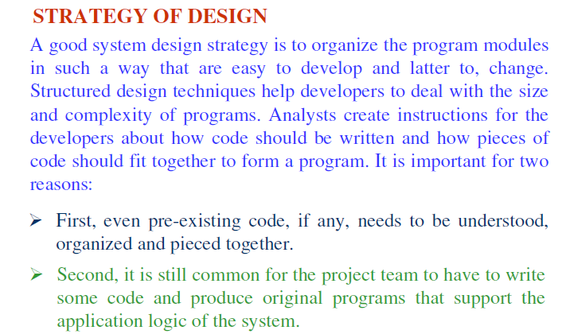

Slide 58
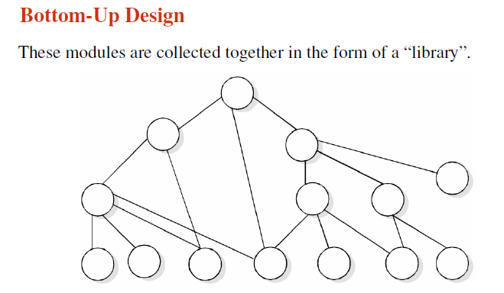

Slide 59
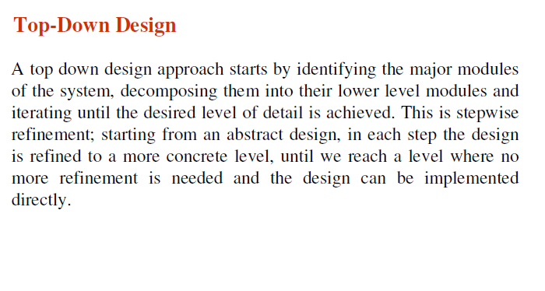

Slide 60
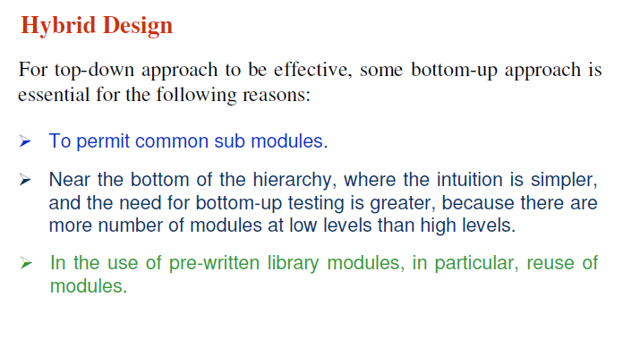

Slide 61
Software Development Approaches
The past
Procedural programs
Deterministic execution
Program in control
The present
Interactive program
Event-driven execution
Objects

Slide 62
Structured Approach
Systematic approaches to develop a software design.
The design is usually documented as a set of graphical models.
Possible models
Object model;
Sequence model;
State transition model;
Structural model;
Data-flow model.

Slide 63
Structured approach
Modeling techniques
DFD
ERD
Problems
Sequential and transformational
Inflexible solutions
No reuse

Slide 64
Structured Approach
The structured paradigm was successful initially
It started to fail with larger products (> 50,000 LOC)
Postdelivery maintenance problems (today, 70 to 80 percent of total effort)
Reason: Structured methods are
Action oriented (e.g., finite state machines, data flow diagrams); or
Data oriented (e.g., entity-relationship diagrams);
But not both

Slide 65
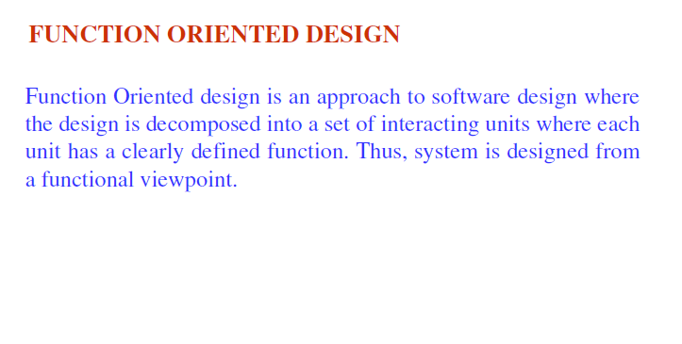

Slide 66
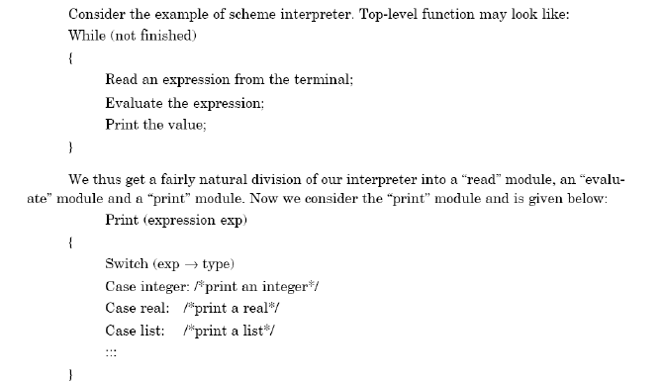

Slide 67
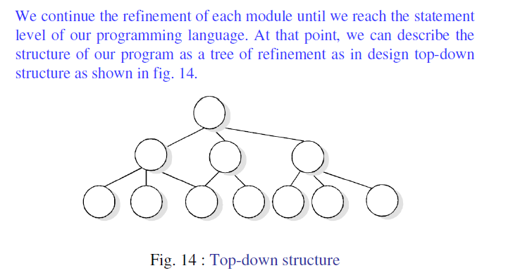

Slide 68
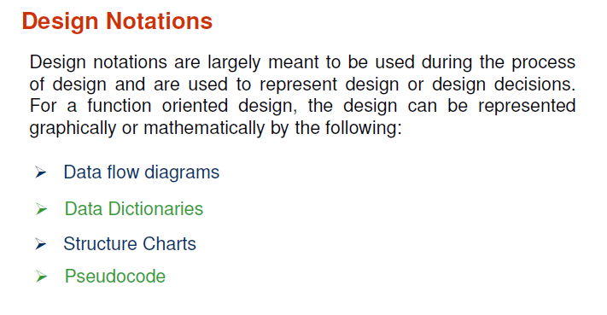

Slide 69
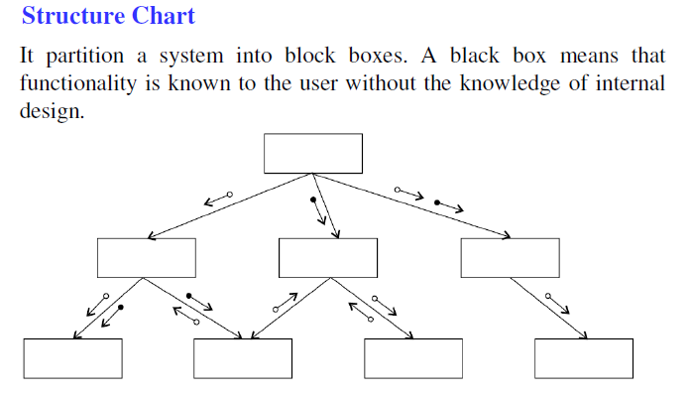

Slide 70
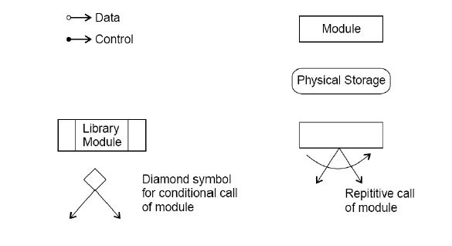
Structure Chart Notations

Slide 71
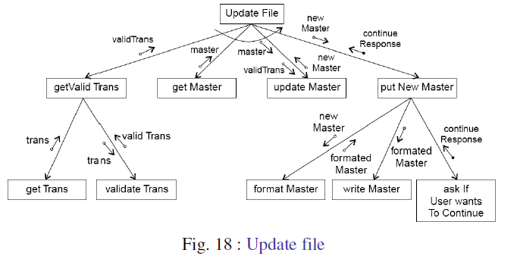
Example

Slide 72
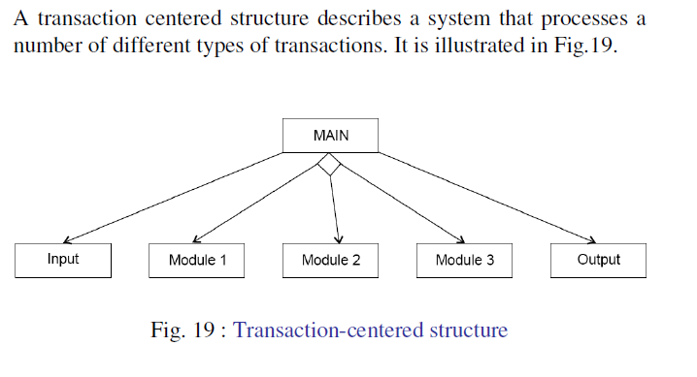
Transaction Centered Structure

Slide 73
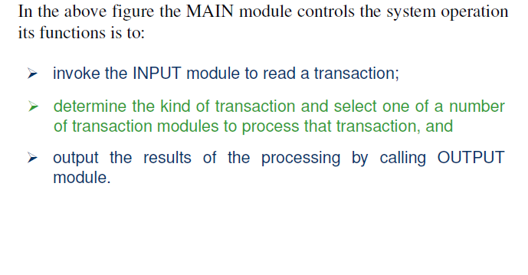
Description

Slide 74
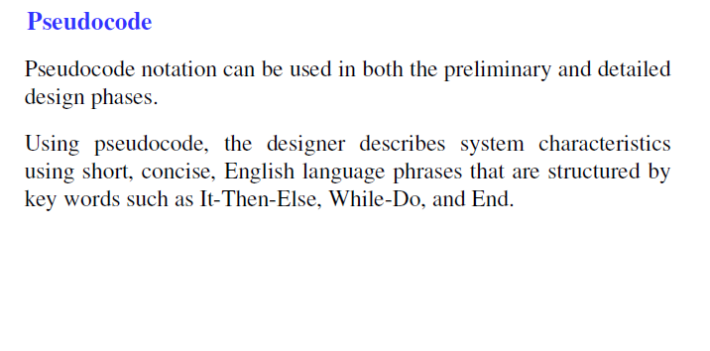

Slide 75
Modules to Objects
Objects with high cohesion and low coupling
⇑
Objects
⇑
Information hiding
⇑
Abstract data types
⇑
Data encapsulation
⇑
Modules with high cohesion and low coupling
⇑
Modules

Slide 76
Object-Oriented approach
Data-centric
Event-driven
Addresses emerging applications
Follows iterative and incremental process

Slide 77
Structured versus Object-Oriented Paradigm
Account Balance
Withdrawal
Deposit
Determine Balance
Account
Balance
With-
drawal
Message
Deposit
Account
Balance
Message
Determine Balance
Message

Slide 78
Strengths of the Object-Oriented Paradigm
With information hiding, postdelivery maintenance is safer
The chances of a regression fault are reduced
Development is easier
Objects generally have physical counterparts
This simplifies modeling
Well-designed objects are independent units
Everything that relates to the real-world object being modeled is in the object — encapsulation
Communication is by sending messages
This independence is enhanced by responsibility-driven design
A classical product conceptually consists of a single unit
The object-oriented paradigm reduces complexity because the product generally consists of independent units
The object-oriented paradigm promotes reuse
Objects are independent entities

Slide 79
Classical Phases vs Object-Oriented Workflows
Classical paradigm
Requirements phase
Analysis (specification) phase
Design phase
Implementation phase
Post-delivery maintenance
Retirement
Object-Oriented paradigm
Requirements workflow
Object-Oriented Analysis workflow
Object-Oriented Design workflow
Object-Oriented Implementation workflow
Post-delivery maintenance
Retirement
There is no correspondence between phases and workflows

Slide 80
In More Detail
Classical paradigm
Analysis (specification) phase
Determine what the product is to do
Design phase
Architectural design
Detailed design
Implementation phase
Code the modules in an appropriate programming language.
Integrate
Object-Oriented paradigm
Object-Oriented Analysis workflow
Determine what the product is to do
Extract the classes
Object-Oriented Design workflow
Detailed design
Object-Oriented Implementation workflow
Code the modules in an appropriate OO programming language.
Integrate
Objects enter here
Modules (objects) are introduced as early as the object-oriented analysis workflow
This ensures a smooth transition from the analysis workflow to the design workflow
The objects are then coded during the implementation workflow
Again, the transition is smooth

Slide 81
Modeling Primitives
Objects
an entity that has state, attributes and services
Interested in problem-domain objects for requirements analysis
Classes
Provide a way of grouping objects with similar attributes or services
Classes form an abstraction hierarchy though ‘is_a’ relationships
Attributes
Together represent an object’s state
May specify type, visibility and modifiability of each attribute
Relationships
‘is_a’ classification relations
‘part_of’ assembly relationships
‘associations’ between classes

Slide 82
Modeling Primitives
Methods (services, functions)
These are the operations that all objects in a class can do…
…when called on to do so by other objects
E.g. Constructors/Destructors (if objects are created dynamically)
E.g. Set/Get (access to the object’s state)
Message Passing
How objects invoke services of other objects
Use Cases/Scenarios
Sequences of message passing between objects
Represent specific interactions

Slide 83
Key Principles
Classification (using inheritance)
Classes capture commonalities of a number of objects
Each subclass inherits attributes and methods from its parent
Forms an ‘is_a’ hierarchy
Child class may ‘specialize’ the parent class
by adding additional attributes & methods
by replacing an inherited attribute or method with another
Multiple inheritance is possible where a class is subclass of several different super classes.

Slide 84
Key Principles
Information Hiding
internal state of an object need not be visible to external viewers
Objects can encapsulate other objects, and keep their services internal
useful for forming abstractions
Aggregation
Can describe relationships between parts and the whole

Slide 85
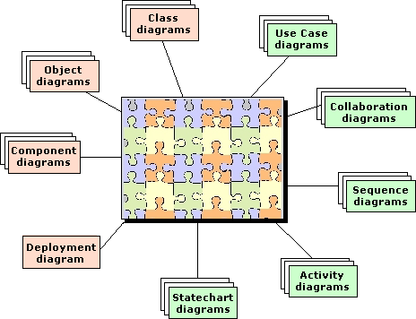
UML Diagram Types (9)
These can be classified into 'static' and 'dynamic' diagrams.
Static
Structure
Class diagram
Object diagram
Implementation
Component diagram
Deployment diagram
Dynamic
Functionality
Use Case diagram
Behavior
Activity diagram
State chart diagram
Interaction
Collaboration diagram
Sequence diagram
System
Model

Slide 86
Software Measurement
Software Measurement: Quantitative
determination of an attribute of the software.
Why to Measure the Software ?
To gain insight by providing mechanisms for
objective evaluation.
To improve understanding of particular entities
and attributes

Slide 87
Software Measurement
Developers measure software to check whether
Requirements are consistent and complete.
Design is of high quality.
Code is ready to be tested.
Project Managers measure software to
Decide about delivery date (Schedule).
Check the Budget.
Evaluate Attributes of process and product.
Customers measure software to check
Whether Requirements are met ?
Quality of the product.
Attributes of the final product.
Maintainers measure software to decide
What to be up-graded and improved ?
Aspects of adaptability.

Slide 88
Software Measurement Objectives
Indicate quality of the Software.
Assess the productivity of the people.
Assess benefits derived from new methods and tools.
Form baseline for future estimation.
Justifications for new tools and training.
To ensure control in project management.
“You can not control what you can not measure” - DeMarco (1982)

Slide 89
What to Measure ?
Size
Complexity
Reliability
Quality
Coupling and Cohesion
Cost
Duration
Efforts

Slide 90
Function Points
Parameter
Simple
+
Average
+
Complex
=
F_{i}
Distinct input items
3( )
+
4( )
+
6( )
=
?
Output screens/ reports
4( )
+
5( )
+
7( )
=
?
Types of user queries
3( )
+
4( )
+
6( )
=
?
Number of files
7( )
+
10( )
+
15( )
=
?
External interface
5( )
+
7( )
+
10( )
=
?
Total
=
?

Slide 91
Function Point Equation
FP = T * (0.65 + 0.01 * Q)
Where T = unadjusted table total
Q = score from questionnaire
(14 items with values 0 to 5)
Cost of producing one function point? May be organization specific.

Slide 92
Function Point Questionnaire
Backup.
Data communication.
Distributed processes.
Optimal performance.
Heavily used operating system.
On-line data security.
Multiple screens.
On-line master file update.
Complex inputs, queries, outputs.
Complex internal processing.
Reusable code.
Conversion or installation.
Multiple user sites.
Ease of use.

Slide 93
Halstead’s Software Science
Assumptions
complete algorithm specification exists
programmer works alone
programmer knows what to do
Based on counting
n1 = # of unique operators
n2 = # of unique operands
N1 = # of occurrences of operators
N2 = # of occurrences of operands

Slide 94
Halstead Equations
Program Vocabulary (n) = n1+n2
Program Length (N) = N1+N2
Program Length (N) = n1* log₂ (n1) + n2* log₂ (n2)
Program Volume (V) = N* log₂ (n)
Program Level (L) = V*/V = (2/n1)*(n2/N2)
Effort (E) = V/L = V² /V*=V*[(n1*N2)/(2*n2)]
Language Level (l) = LV* (Constant)
Time (T)= E/B where B = (18) 5 to 20

Slide 95
Example1
PROGRAM1(input,otput)
VAR
a,b,c,d,m: integer;
BEGIN
readln(a,b,c,d);
a:= a+a;
b:=b+b;
c:=c*d;
m:= a+b-c;
writeln(m);
END.

Slide 96
Calculations (Example1)
n1=11 (BEGIN_END , readln () ; := + * - writeln .)
n2= 5 (a b c d m)
N1=23
N2=18
V=41*log(11+5)=164
E= 164*[911*18)/(2*5)]=3247

Slide 97
Example2
PROGRAM2(input,otput);
VAR
a,b,c,d,m: integer;
BEGIN
readln(a,b,c,d);
IF a>b THEN
IF b>c THEN
m:= a+b
ELSE
m:=b+c
ELSE
m:=b+c+d;
writeln(m)
END.

Slide 98
Calculations (Example2)
n1 = 11 (BEGIN_END readln () , ; IF-THEN-ELSE > := + writeln .
n2 = 5 (a b c d m)
N1 = 22
N2 = 19
V = 41*log(11+5) = 164
E = 164*[(11*19)/(2*5)] = 3427

Slide 99
Halstead Modified Theory
Certain operators and operands which are part of control statements contribute extra in the count value.
Assign weights so that measures can reflect complexity produced by the non sequential control structures.
Nw1 =Σx in T [1+µ(x)*{L(x)+Adw(x)}]
Nw2 =Σx in R [1+µ(x)*{L(x)+Adw(x)}]
Where µ(x)=1 if x is the part of control statement
= 0 otherwise
L(x) is the level of the statement and Adw(x) is the additional weight assigned depending on the number of test conditions checked for taking decision.

Slide 100
Calculations (Example2)
n1 = 11 (BEGIN_END readln () , ; IF-THEN-ELSE > := + writeln .
n2 = 5 (a b c d m)
Nw1 = N1+6 = 28
Nw2 = N2+6 = 25
Vw = 53*log(11+5) = 212
Ew = 212*[(11*25)/(2*5)] = 5830

Slide 101
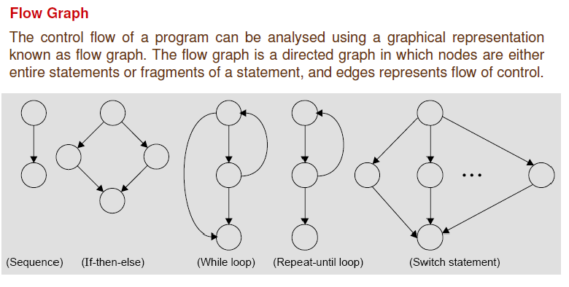
Cyclomatic Complexity Measure

Slide 102
Cyclomatic Complexity
Cyclomatic complexity of the program is computed from its flow graph using the formula
CC(G) = E – N + 2*k where k is number of connected components.
CC(G)=P+1 where P is the number of predicate nodes which can be counted by the conditional statements in the PDL representation.
CC(G)= R+1 where R is the number of closed regions in the flow graph.

Slide 103
Extra/Additional Learning Material

Slide 104
Parts of UML
Class Diagrams
Structure models
Object Diagrams
example models
Use Case Diagrams
document who can do what in a system
Sequence Diagrams
shows interactions between objects used to implement a use case
Collaboration Diagrams
same as sequence diagrams but in different style

Slide 105
Parts of UML (Cont…)
State chart Diagrams
possible states and responses of a class and what transitions them
Activity Diagrams
describe the behavior of a class in response to internal processing
Component Diagrams
Organization of and dependencies amongst software implementation components
Deployment Diagrams
Describe the mapping of software implementation components onto processing nodes

Slide 106
Object
A concept, abstraction, or thing with crisp boundaries and meaning for the problem at hand
promote understanding of the real world
provide a practical basis for computer implementation

Slide 107
Problem Decomposition
Decomposition of a problem into objects depends on
Judgment
The nature of the problem being solved
Not only the domain: two analyses of the same domain will turn out differently depending upon the kind of programs we wish to produce.

Slide 108
Classes
A class describes a group of objects with similar properties.
Class: Instructor
Object: David Penny
Object: Matthew Zaleski
Instructor
Department

Slide 109
Example
Class: Department
Object: Department of Computer Science
Object: Department of Electrical Engineering

Slide 110
Attributes
Data values held by the objects of a class
Instructor
name: string
age: integer
weight: integer

Slide 111
Operations
A function or a transformation that may be applied to or by objects in a class.
Not often used (not often terribly useful) in an OOA
Instructor
name
age
weight teach
mark listen_to_complaints

Slide 112
Links and Associations
The means for establishing relationships among objects and classes.
link: a connection between two object instances
association: a collection of links with common structure and semantics.
Instructor
teaches for
Department

Slide 113
Object Diagrams
Models instances of things contained in class diagrams.
Shows a set of objects and their links at a point in time
Useful preparatory to deciding on class structures.
Useful in order to better explain more complex class diagrams by giving instance examples.

Slide 114
: Department name = “DCS”
i: Instructor name = “Penny”
: Department name = “ECE”
j: Instructor name = “Zaleski”

Slide 115
Multiplicity
Used to indicate the number of potential instances involved in the association when the other associated classes are fixed.
teaches for
Department
*
*
Instructor
A given instructor can teach for potentially many departments or none)
A given department employs zero or more instructors

Slide 116
N-ary Associations
Instructor
teaches
Department
1
1
There is exactly one instructor teaching a given course for a given department
A given instructor teaching for a given department may teach zero or more courses for that department.
*
Course
Try to avoid them!

Slide 117
Attributes on Associations
pay
Instructor
Department
teaches for

Slide 118
Aggregation Indicators (Part-Of)
Department
Window
Implied multiplicity of 1
Student
Frame
Aggregation
(no associated semantics)
Composition
(strong ownership, coincident lifetime)

Slide 119
Generalization (a.k.a. Inheritance, is-a)
Shape
Rectangle
Circle
Triangle
Square

Slide 120
Example
We are asked to build a system for keeping track of the time our workers spend working on customer projects.
We divide projects into activities, and the activities into tasks. A task is assigned to a worker, who could be a salaried worker or an hourly worker.
Each task requires a certain skill, and resources have various skills at various level of expertise.

Slide 121
Steps
Analyze the written requirements
Extract nouns: make them classes
Extract verbs: make them associations
Draw the OOA UML class diagrams
Determine attributes
Draw object diagrams to clarify class diagrams

Slide 122
Steps (contd..)
Determine the system’s use cases
Identify Actors
Identify use case
Relate use cases
Draw sequence diagrams
One per use case
Use to assign responsibilities to classes
Add methods to OOA classes

Slide 123
Example
We are asked to build a system for keeping track of the time our workers spend working on customer projects.
Customer
Worker
*
1
contracts
1
assigned to
spends
*
*
Project
*
against
*
Time
*

Slide 124
Example
We divide projects into activities, and the activities into tasks. A task is assigned to a worker, who could be a salaried worker or an hourly worker.
Project
spent on ◄
Time
Assignment
1..*
1
Worker
Activity
assigned to
1..*
Task
*
SalariedWorker
HourlyWorker

Slide 125
Example
Each task requires a certain skill, and workers have various skills at various level of expertise.
Worker
Task
*
*
Skill
has
requires ◄
1..*
1..*
SkillLevel

Slide 126
Steps
Analyze the written requirements
Extract nouns: make them classes
Extract verbs: make them associations
Draw the OOA UML class diagrams
Determine attributes
Draw object diagrams to clarify class diagrams
Determine the system’s use cases
Identify Actors
Identify use case
Relate use cases

Slide 127
Example
Customer
companyName primeContact address phone fax
contracts
Project
N.B.
Project has no attribute in Customer
association is enough
no database id for Customer shown
in an OOA, only include an id if visible to users
may include such things during database design or OOD

Slide 128
Example
Project
name description startDate: date
contracts ◄
Customer
Activity
name description startDate: date estHours: int deliverable: string
Task

Slide 129
Example
Activity
Constraint: A task may only be assigned to a worker who has the required skill.
Task
description startDate: date estHours: int
requires
Skill
assigned to
has
Worker

Slide 130
Example
SkillLevel
level: int rateMultiplier: real
Skill
name: string
has
assigned to
Worker
name: string
Task
SalariedWorker
salary: real vacationDays: int
HourlyWorker
hourlyWage: real

Slide 131
Example
Time
start: dateTime end: dateTime hours: real
spent on
Assignment
Task
assigned to
Worker

Slide 132
Steps
Analyze the written requirements
Extract nouns: make them classes
Extract verbs: make them associations
Draw the OOA UML class diagrams
Determine attributes
Draw object diagrams to clarify class diagrams
Determine the system’s use cases
Identify Actors
Identify use case
Relate use cases
Draw sequence diagrams
One per use case
Use to assign responsibilities to classes
Add methods to OOA classes

Slide 133
Object Diagrams
:Time
start: Jan.23, 2002, 8:00 end: Jan.23, 2002, 18:00 hours: 4.2
:Assignment
:Task description: “develop class diagrams”
:Worker
name: “Matt”

Slide 134
Steps
Analyze the written requirements
Extract nouns: make them classes
Extract verbs: make them associations
Draw the OOA UML class diagrams
Draw object diagrams to clarify class diagrams
Determine attributes
Determine the system’s use cases
Identify Actors
Identify use case
Relate use cases
Draw sequence diagrams
One per use case
Use to assign responsibilities to classes
Add methods to OOA classes

Slide 135
Use Cases
Actors:
Represent users of a system
human users
other systems
Use cases
Represent functionality or services provided by a system to its users

Slide 136
Use Case Diagrams
Time & Resource Management System (TRMS)
Manage Resources
resource manager
Manage Projects
project manager
Log Time
worker
Administer System
<<actor>> Backup System
system administrator

Slide 137
Resource Manager Use Cases
Add Skill
Remove Skill
Find Skill
<<uses>>
resource manager
Update Skill
<<uses>>

Slide 138
More Resource Manager Use Cases
Add Worker
Remove Worker
<<uses>>
Find Worker
<<uses>>
Update Worker
resource manager
<<extends>>
<<extends>>
Assign Skill to Worker
Unassign Skill from Worker
<<uses>>
Find Skill

Slide 139
Steps
Analyze the written requirements
Extract nouns: make them classes
Extract verbs: make them associations
Draw the OOA UML class diagrams
Draw object diagrams to clarify class diagrams
Determine attributes
Determine the system’s use cases
Identify Actors
Identify use case
Relate use cases
Draw sequence diagrams
One per use case
Use to assign responsibilities to classes
Add methods to OOA classes

Slide 140
Sequence Diagram – Assign Skill to Worker Use Case
resource manager
Res. Mgr. Win: UI
:Worker
:Skill
:SkillLevel
find worker
find worker by name
find skill
find skill by name
assign skill to worker
[worker does not currently have skill] assign skill to worker

Slide 141
Steps
Analyze the written requirements
Extract nouns: make them classes
Extract verbs: make them associations
Draw the OOA UML class diagrams
Draw object diagrams to clarify class diagrams
Determine attributes
Determine the system’s use cases
Identify Actors
Identify use case
Relate use cases
Draw sequence diagrams
One per use case
Use to assign responsibilities to classes
Add methods to OOA classes

Slide 142
Add Methods
Read sequence diagrams to identify necessary methods
Worker
name: string
+ static Worker findWorker(String name); + static list of Workers getWorkers();

Slide 143
In Design
Bring methods closer to implementation
Worker
name: string
+ static Worker findWorker(String name); + static int getNWorkers(); + static Worker getWorker(int);

Slide 144
In Design
Bring methods closer to implementation
WorkList
Int getNumListElements();
String getListElement(int n);
ListModel
int getNumListElements();
String getListElement(int n);
Worker
name: string
+ static Worker findWorker(String name);

